Slide 1


PyramidFL: A Fine-grained Client Selection Framework for Efficient Federated Learning
Chenning Li, Xiao Zeng, Mi Zhang, and Zhichao Cao
Edge Intelligence & Networking Lab@Michigan State University
Notes:
Thank Prof. Xing for the introduction. I am gald to be here and share our work PyramidFL for improving the global efficiency of federated learning.

Slide 2





Privacy-sensitive Machine Learning
Activity monitoring
Home automation
Edge Devices:
1. Massive sensory data
2. Rich computation resources
Voice assisting
Precise agriculture
Privacy-sensitive Machine Learning
Notes:
The story starts from the privacy concerns in centralized machine leanring systems. We know that more and more edge devices and sensors are deeply coupled with our daily life and industry production. They generate massive sensory data and data-driven machine learning models are widely adopted to enable many applications like (activity monitoring, home automation, voice assiting, and precise agriculture), but these applications are usually privacy-sensitive for users. Thus, how to building a privacy-aware machhine learning framework becomes a problem. A good news is that the edge devices have richer computation resources than ever.

Slide 3


Federated Learning
Edge device
Local stochastic gradient descent (SGD) training
Model update uploading
Central server
Client selection
Model updates aggregating
Time-to-accuracy
Less time to achieve target accuracy
Hundreds or even millions edge-devices
Data Heterogeneity
System Heterogeneity
Central Server
System Heterogeneity
Network Bandwidth
Computing Resource
Edge Devices
Data Heterogeneity
Non-i.i.d. Local Data
Notes:
By fully utilizing the local computation ability, Federated Learning (FL) divide the machine learning process into two part: edge device and central server. Instead of uploading pravicy-sensititive data directly, edge devices train a global model locally and upload the model updates. The central server selects client for training in each round and aggregate the model updates until the global model converge. The main performance metric is called time-to-accuracy indicating to the time used to achieve target accuracy. The less the time we use, the better the performance is. Considering hunderdes or even millions participants in a large scale FL system, two well-known challenges have been widely studied for improving the time-to-accuracy performance. One is data heterogeneity in terms of non-iid local data. The other is system heterogeneity in terms of network bandwidth and computing resource.

Slide 4

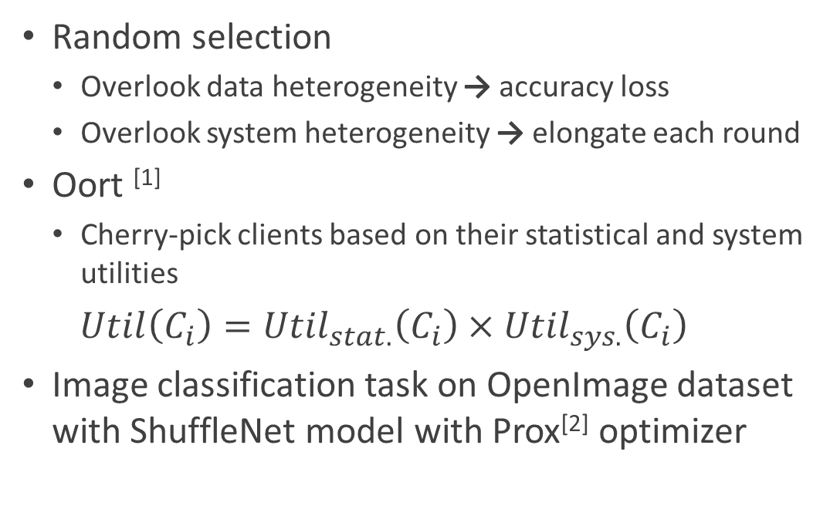
Client Selection
Better
Random selection
Overlook data heterogeneity → accuracy loss
Overlook system heterogeneity → elongate each round
Oort ^{[1]}
Cherry-pick clients based on their statistical and system utilities
$Util\left(C_{i}\right)={Util}_{stat.}\left(C_{i}\right)×{Util}_{sys.}\left(C_{i}\right)$
Image classification task on OpenImage dataset with ShuffleNet model with Prox^{[2]} optimizer
Acc. Loss
Improved time-to-acc.
[1] “Oort: Efficient Federated Learning via Guided Participant Selection”, OSDI’21
[2] “Federated Optimization in Heterogeneous Networks”, MLSys’20
Notes:
Moreover, how to select clients in each round is a critical problem beyond the data heterogeneity and system heterogeneity. The default client selection of existing FL systems is random selection. Although the random selection is easy to implement, the time-to-accuracy performance is hard to be guaranteed. For example, we would converge to a less accurate model if the selected data is biased. Or the training time of each round is elongated if the network situation of the selected clients is bad.
Oort is the first paper that notice the importance of client selection in FL. It selects several clients with the highest utilities combining both statistical and system efficiency into consideration.
We conduct an empirical study over image classfication task to show our design space. The purple line indicates the highest accuracy we could achieve over a cetralized training. It would be better if we can lower the training time. Moreover, in comparison with random client selection, Oort indeed inproves the time-to-accuracy performance, but still experience model accuracy loss. In this work, we intend to further enhance the time-to-accuracy performance as the red curve shown.

Slide 5
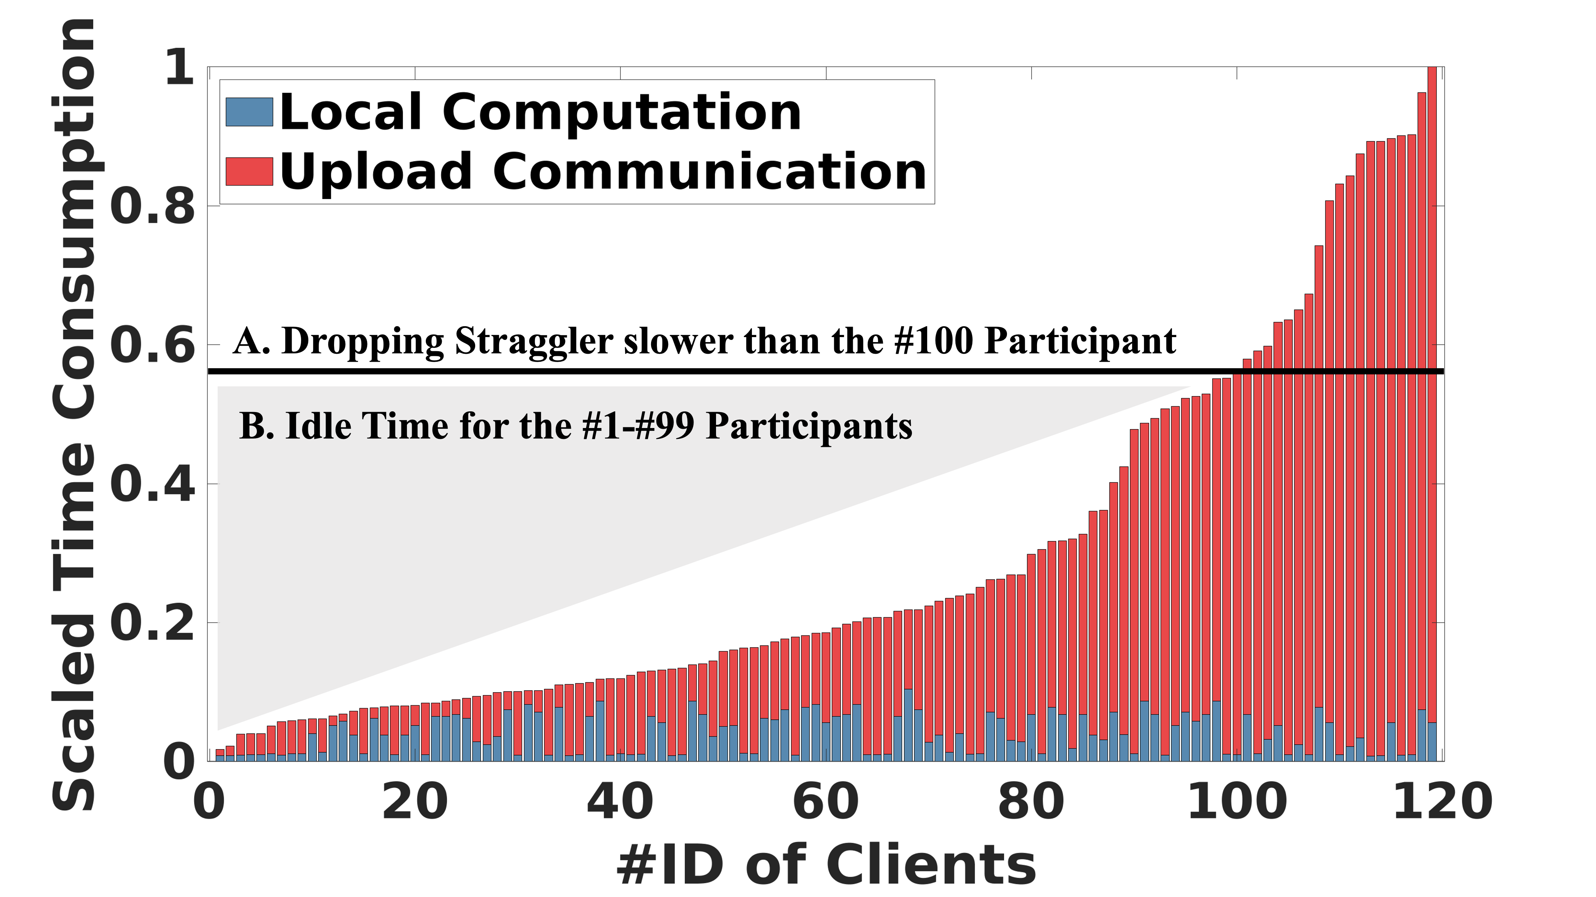
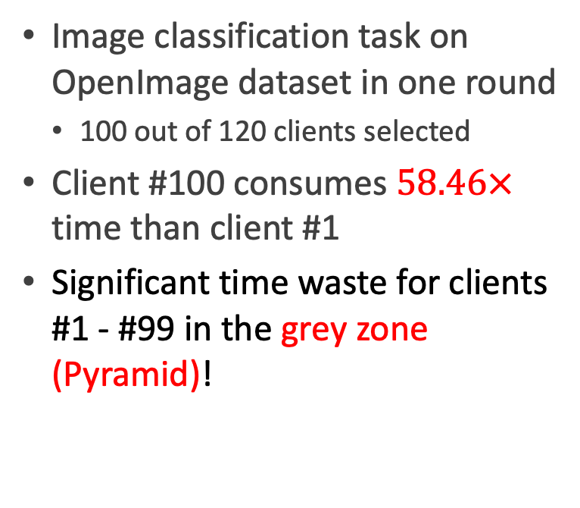
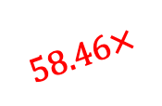
Limitation of Oort
Image classification task on OpenImage dataset in one round
100 out of 120 clients selected
Client #100 consumes $58.46×$ time than client #1
Significant time waste for clients #1 - #99 in the grey zone (Pyramid)!
$$58.46×$$
Notes:
Let’s take a close look at the limitation of Oort. In our empirical study, Oort selects 120 clients in each roudn and aggrates the first 100 feedback. The rest of 20 slow clients will be treated as straggler. We sort the time consumption of the selected clients including local computation and upload communication in asending order. We can see that the training time consumption of client 100 is 58.46 times higher than that of client 1. The Pyramid like grey zone leaves us the opportunities to further enhance the time-to-accuracy by exploring the data and system efficiency of clients 1 to 99.

Slide 6
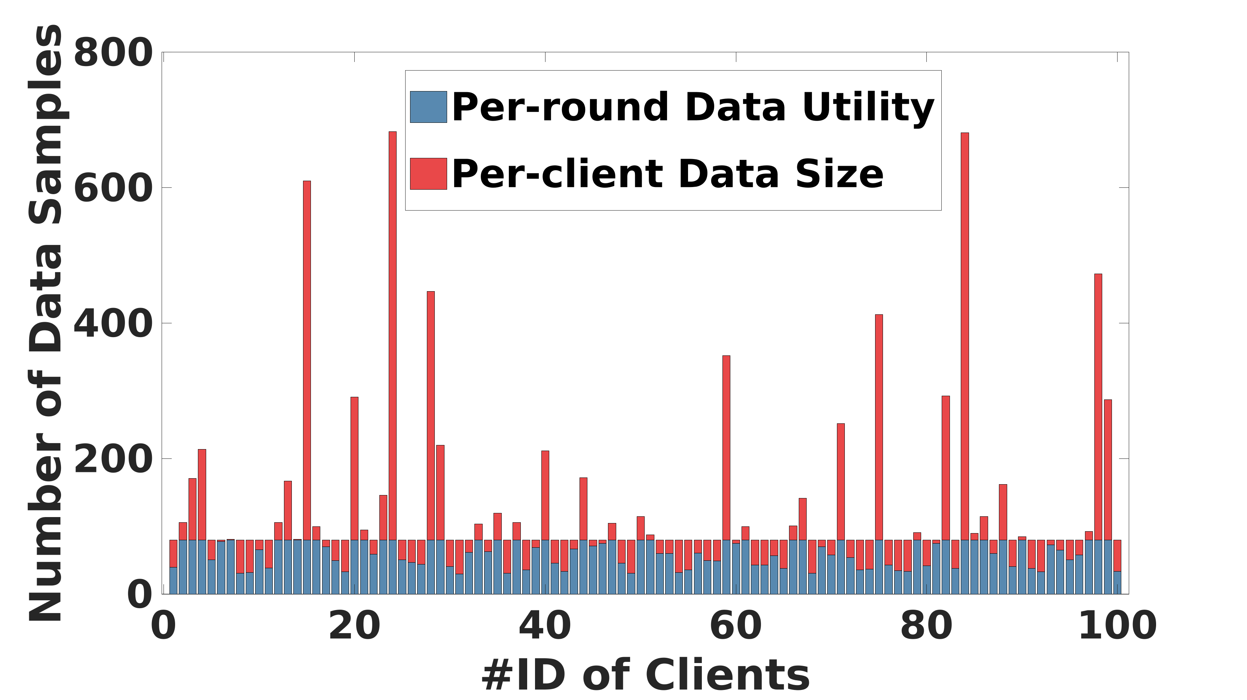
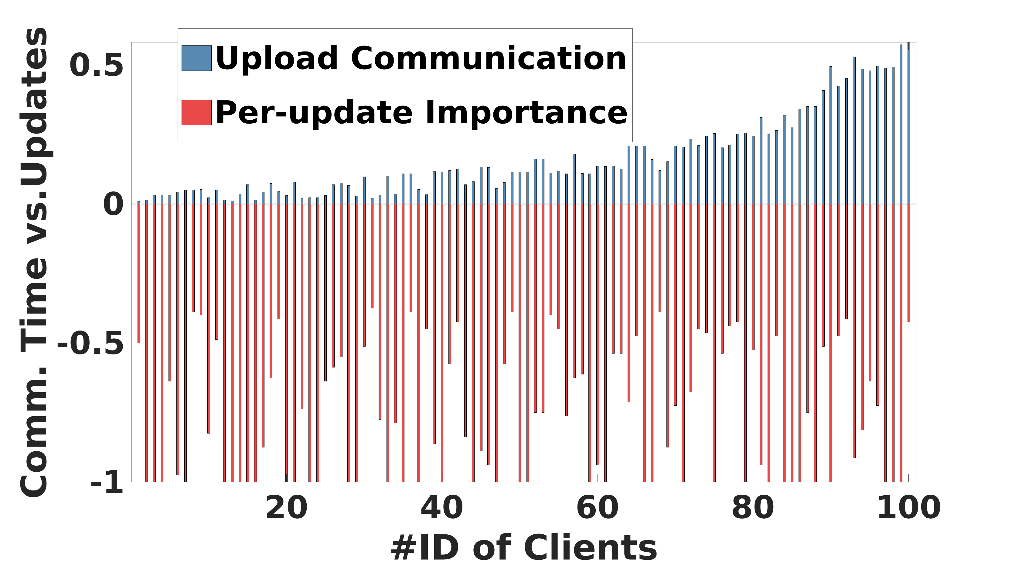
Key Observations
Under-exploited Statistical Efficiency
data samples seen per round < local total
Under-exploited System Efficiency
Comm. cost > update importance
Notes:
To fully utlize the time in the pyramid area, we have two key observations. First, the data samples used for local training in one round (blue bar) are usually samller than the total amount of the local data (red bar). Hence, clients have the time to see more data to boost the statistical efficiency in each round. Second, we observe that the communication cost (blue bar) is not relative to whether the uploaded model updates are important for improving global model accuracy. Hence, if the update importance is low, clients could drop some updates to improve the system efficiency.

Slide 7
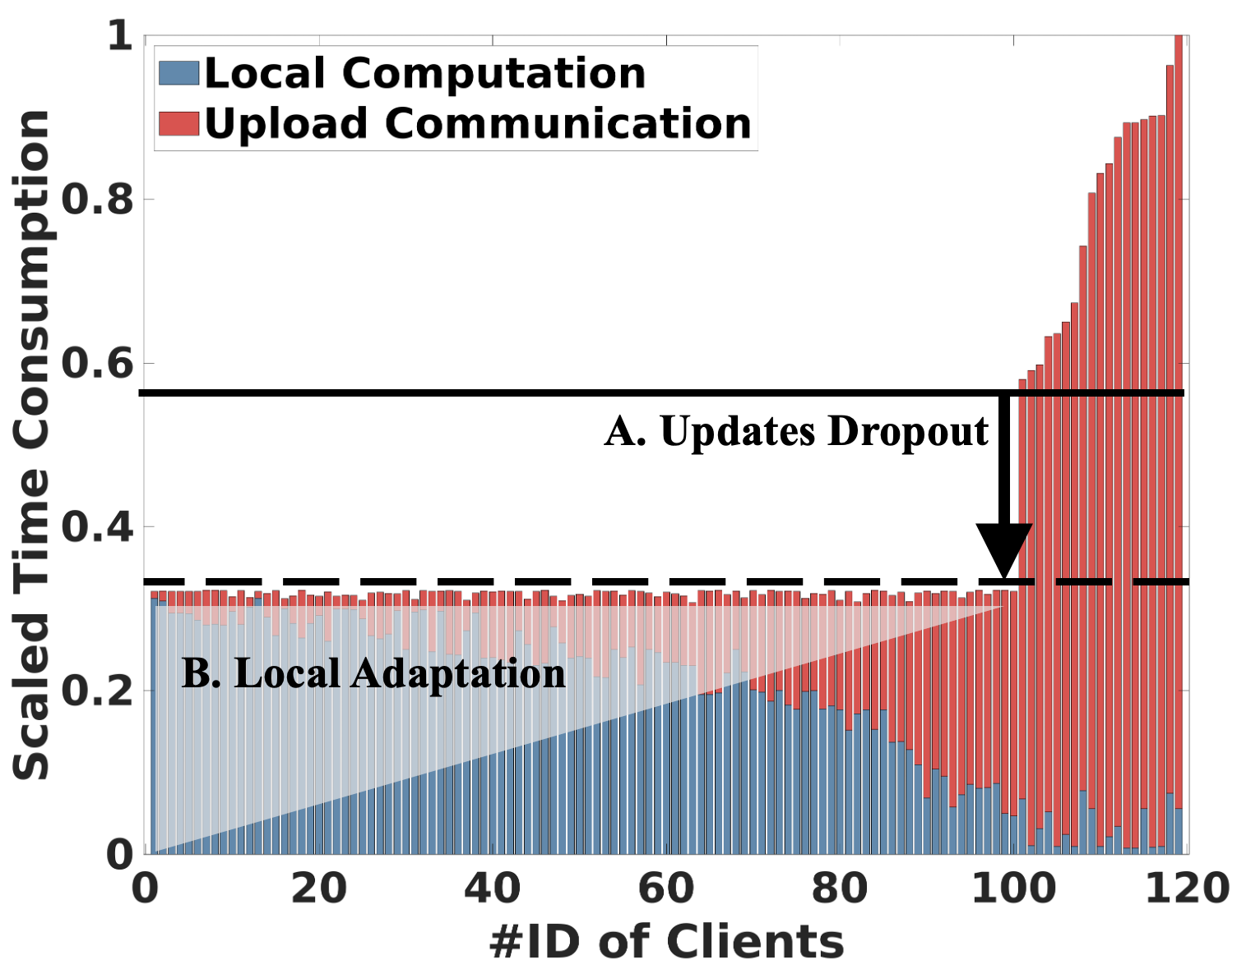
Overview of PyramidFL
Exploit fine-grained data and system utilities within selected clients
Data Efficiency: train more iterations
System Efficiency: drop useless updates
Notes:
Overall, we propose PyramidFL that exploits fine-grained data and system utilities within selected clients. Specifically, for a selected client, it will optimize its local utility. First, it will try the best to see more data under the constraints of its network condition. Moreover, the client will drop the useless updates to optimize its system efficiency so that it has more time to train more iterations. The central server will rank the update importance across different selected clients and disseminate the ranking information to selected clients so that they can determine how much model updates they should drop.

Slide 8
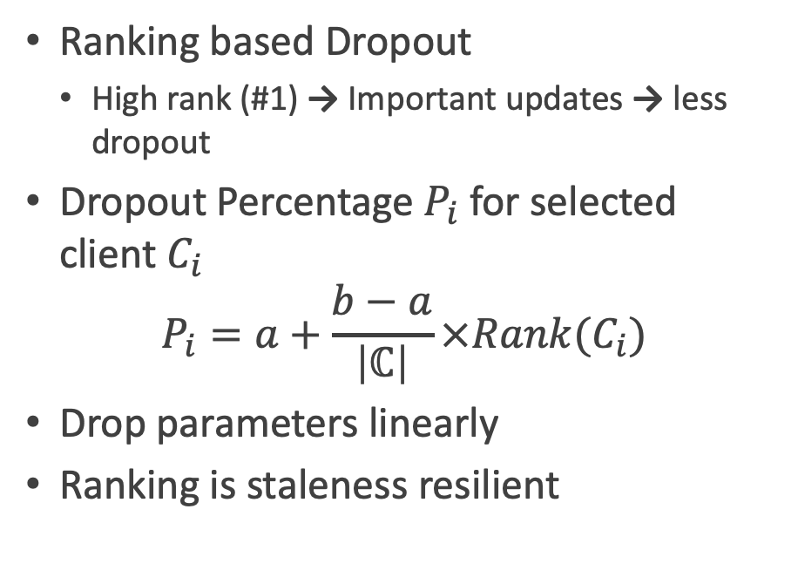
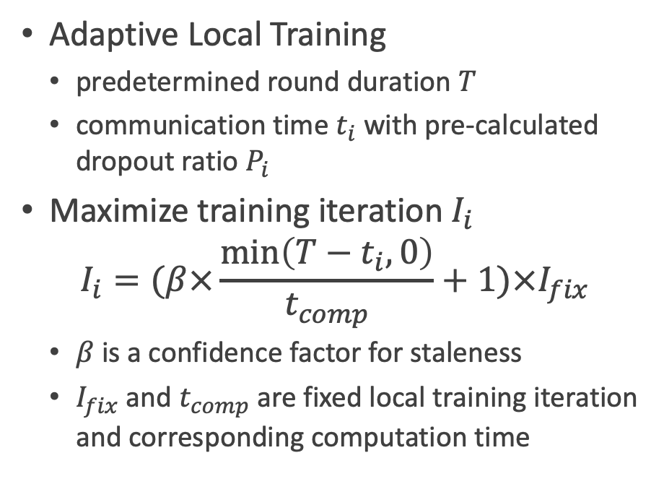
Challenge 1: Local Utility Optimization
Ranking based Dropout
High rank (#1) → Important updates → less dropout
Dropout Percentage $P_{i}$for selected client $C_{i}$
$$P_{i}=a+\frac{b−a}{\left|ℂ\right|}×Rank(C_{i})$$
Drop parameters linearly
Ranking is staleness resilient
Adaptive Local Training
predetermined round duration $T$
communication time $t_{i}$ with pre-calculated dropout ratio $P_{i}$
Maximize training iteration $I_{i}$
$$I_{i}=(β×\frac{\min\left(T−t_{i},0\right)}{t_{comp}}+1)×I_{fix}$$
$β$ is a confidence factor for staleness
$I_{fix}$ and $t_{comp}$ are fixed local training iteration and corresponding computation time
Notes:
In our design, the first challene is how to opitmize the local unitility since the data efficiency and system efficiency is usually twsited. Our method is to determine the dropout ratio first based on the global ranking. We hope the higher the rank is, the less dropout is. We use two hyperparameters a and b to determine the dropout ratio, where a is the lowest ratio and b is the highest. During the dropout, we drop parameter linearly. Hence, the ranking based dropout ratio is staleness resilient.
Then, given the predetermined round duration T and communication time ti needed under the pre-calculated dropout ratio Pi, we can calculate the maximum training iteration I with the following equation, where beta is a confidence factor for staleness and Ifix and tcomp indicate a fixed local training iteration and the corresponding computation time.

Slide 9
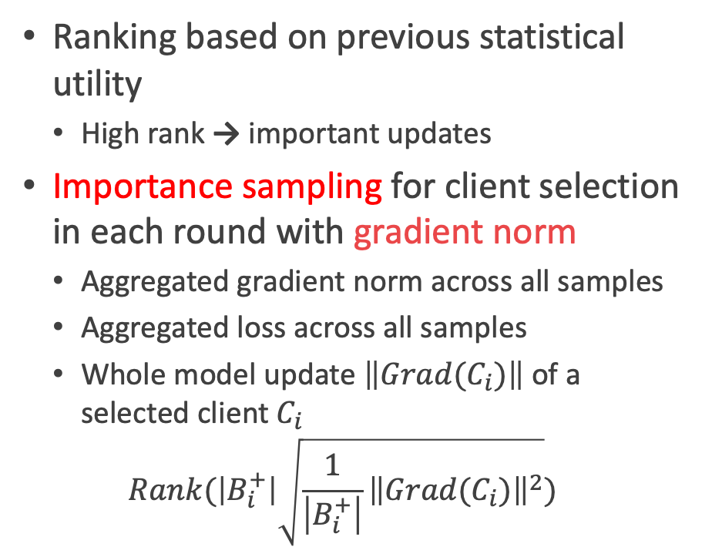
Challenge 2: Computation Efficient Ranking Calculation
Ranking based on previous statistical utility
High rank → important updates
Importance sampling for client selection in each round with gradient norm
Aggregated gradient norm across all samples
Aggregated loss across all samples
Whole model update $\left\|Grad(C_{i})\right\|$ of a selected client $C_{i}$
$$Rank(\left|B_{i}^{+}\right|\sqrt{\frac{1}{\left|B_{i}^{+}\right|}{\left\|Grad(C_{i})\right\|}^{2}})$$
Computation Cost
all samples’
gradient norm
model update gradient norm
all samples’
loss
Ranking
Accuracy
Notes:
We can see the ranking information plays an important role in determing the local utilization of each selected client. We conduct importance smpaling across the selected clients in each round with their gradient norm. For the computation of gradient norm, we have serveral choices to balance the ranking accuracy and the computation efficiency. Gradient norm across all samples is the most accuracy, but the compuation overhead is not acceptable. The computation cost of loss across all samples is low, but the ranking accuracy is low as well. Instead, we use the model update gradient norm to achieve an accurate ranking calculation while preserving the compuation efficient.

Slide 10
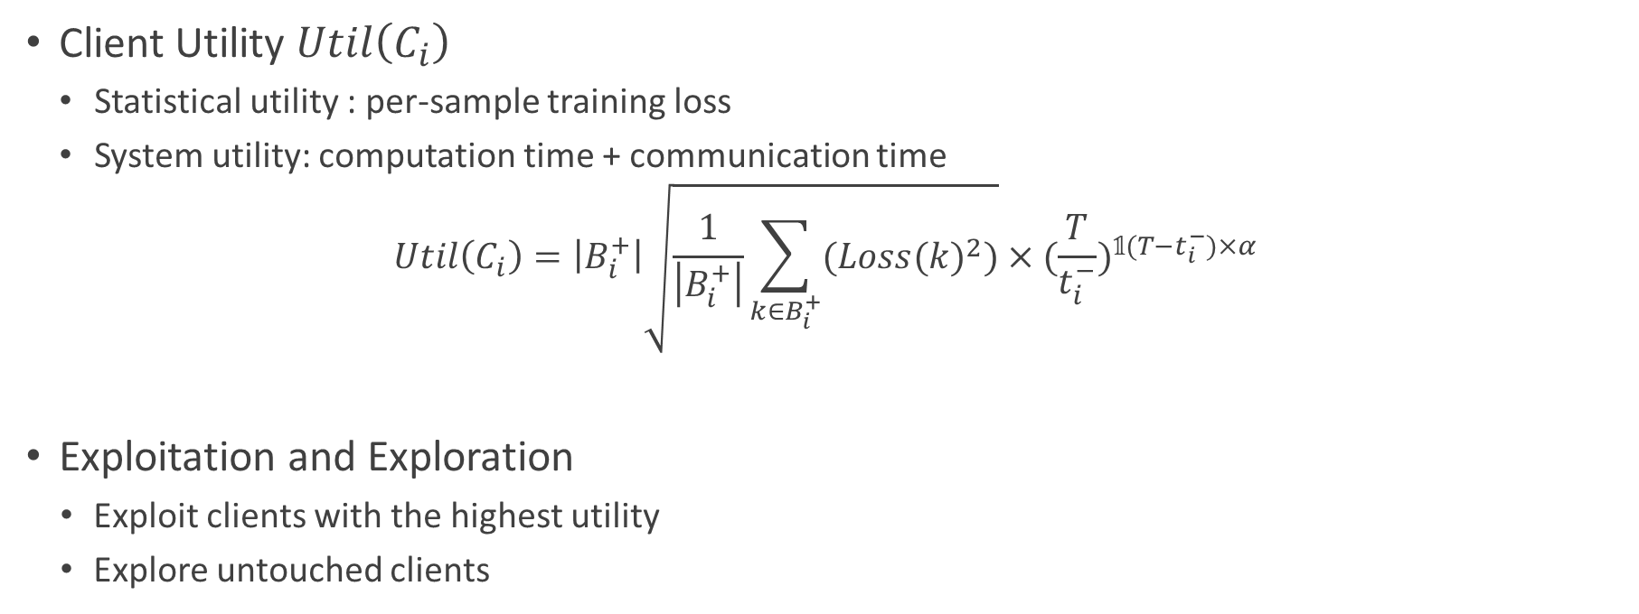
Challenge 3: Global Client Selection
Client Utility $Util\left(C_{i}\right)$
Statistical utility : per-sample training loss
System utility: computation time + communication time
$$Util\left(C_{i}\right)=\left|B_{i}^{+}\right|\sqrt{\frac{1}{\left|B_{i}^{+}\right|}\sum_{k∈B_{i}^{+}}{({Loss(k)}^{2})}}×{(\frac{T}{t_{i}^{−}})}^{𝟙(T−t_{i}^{−})×α}$$
Exploitation and Exploration
Exploit clients with the highest utility
Explore untouched clients
Statistical
System
Notes:
The last challenge is how to select the clients with their local optimized utility. Similar to Oort, we redefine the utility function for each client including statistical utility demonstrating the training loss over all seen data samples, and the system utility considering the local compuation time and communication time with update dropout. We will cherry-pick the clients with the highest utility and explore the untouched clients as well.

Slide 11
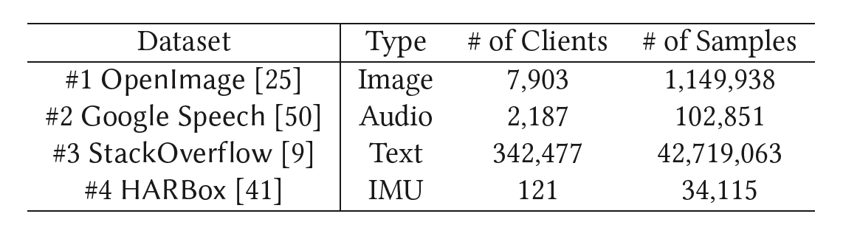
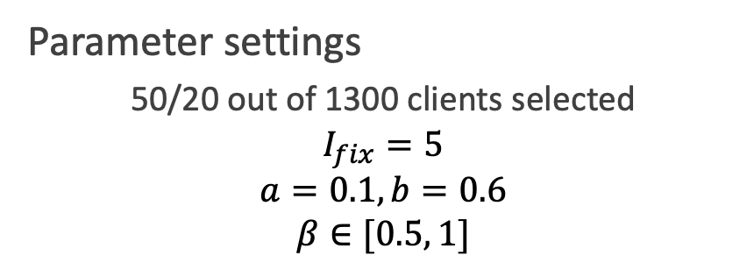
Implementation & Evaluation
Implement PyramidFL with FedScale ^{[1]}
Four tasks, datasets, and ML models
Parameter settings
50/20 out of 1300 clients selected
$$I_{fix}=5$$
$$a=0.1, b=0.6$$
$$β∈[0.5, 1]$$
[1] “FedScale: Benchmarking Model and System Performance of Federated Learning at Scale”, ICML’22
Notes:
We implement PyramidFL with FedScale with total nine function modules. We evaluate the performance of PyramidFL on four dataset including image, audio, test, and gesture IMU data. Part of the system parameter settings are adopted from Oort and the other parts are empirically determined.

Slide 12
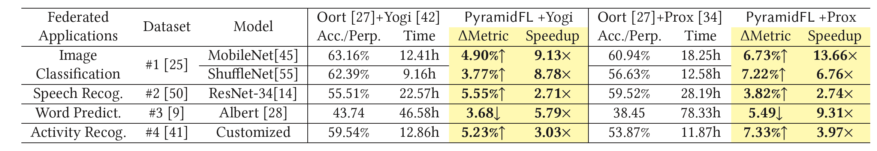
Time-to-Accuracy Performance
OpenImage + ShuffleNet + Prox
Speech + ResNet-34 + Prox
Notes:
First of all, let’s look at the overall improvement of time-to-accuracy. The purple line is ours and the yellow one is oort. For image classification task, we could achieve a 7.22% model accuracy improvement and 6.76 time speedup for the converge time. The improvement of both model accuracy and converge time can be seen for the speech recognition task.

Slide 13
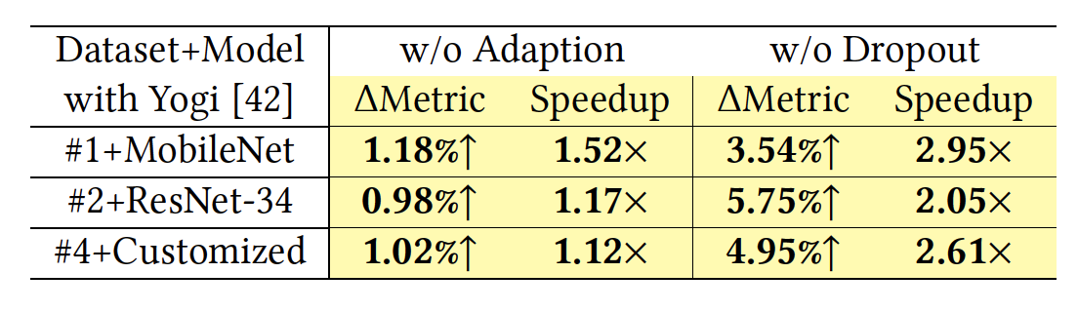
Component-wise Analysis
OpenImage
Speech
Notes:
Moreover, we show the performance of both adaption training and dropout. We can see both adaption and dropout can improve the model accuracy and converge time individually while the improvement from adaption is larger than that from dropout.

Slide 14
Summary
PyramidFL
a fine-grained client selection framework for FL
@Server
data and system utility based client selection
statistical utility based client ranking
@Selected clients
ranking based dropout (system efficiency)
adaptive local training (data efficiency)
Time-to-Accuracy Performance
Model accuracy 3.68% – 7.33% improment
Wall clock time 2.71 – 13.66 times speedup
Better
Accuracy
Training Time
Notes:
To conclude, we propose PyramidFL, a fine-grained client selection framework for FL. The core design and innovation incluces the utility based client selection and client ranking at server side, and the dropout and adative training at client side. The evaluation results show that PyramidFL can approch to the ideal performance on different datasets.

Slide 15
Thank you! Q&A
PyramidFL Datasets and Codes: https://github.com/liecn/PyramidFL
caozc@msu.edu
Notes:
Thank you and questions are welcom.

